Slide 1
ITNW 1335 Cloud Computing
Chapter 9 – Cloud Management Mechanisms

Slide 2
Cloud Management Mechanism
Cloud-based IT resources need to be set up, configured, maintained, and monitored.
The systems below are mechanisms that encompass and enable these types of management tasks.
Remote Administration System
Resource Management System
SLA Management System
Billing Management System
They form key parts of cloud technology architectures by facilitating the control and evolution of the IT resources that form cloud platforms and solutions.

Slide 3
Cloud Management Mechanism
These systems typically provide integrated APIs and can be offered as individual products, custom applications, or combined into various product suites or multi-function applications.

Slide 4
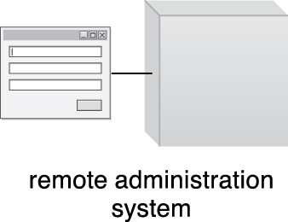
9.1. Remote Administration System
The remote administration system mechanism provides tools and user-interfaces for external cloud resource administrators to configure and administer cloud-based IT resources
Figure 9.1 The symbol used in this book for the remote administration system. The displayed user-interface will typically be labeled to indicate a specific type of portal.
Notes:
Figure:

Slide 5
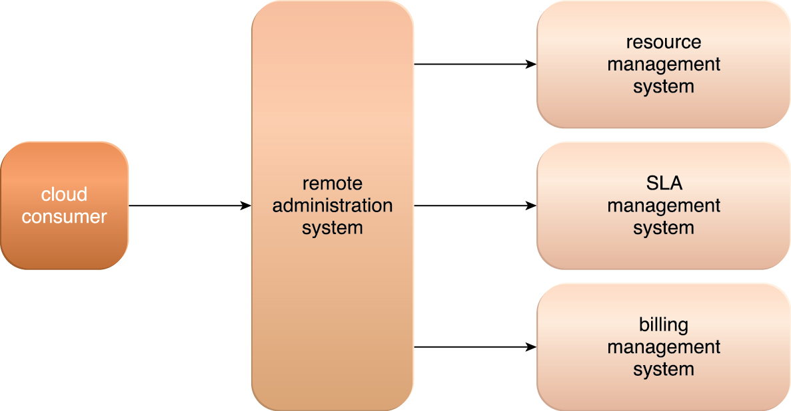
9.1. Remote Administration System
A remote administration system can establish a portal for access to administration and management features of various underlying systems, including the resource management, SLA management, and billing management systems
Figure 9.2 The remote administration system abstracts underlying management systems to expose and centralize administration controls to external cloud resource administrators. The system provides a customizable user console, while programmatically interfacing with underlying management systems via their APIs.
Notes:
Figure:

Slide 6
9.1. Remote Administration System
The tools and APIs provided by a remote administration system are generally used by the cloud provider to develop and customize online portals that provide cloud consumers with a variety of administrative controls.
There are two primary types of portals that are created with the remote administration system
Usage and Administration Portal – A general purpose portal that centralizes management controls to different cloud-based IT resources and can further provide IT resource usage reports
Self-Service Portal – This is essentially a shopping portal that allows cloud consumers to search an up-to-date list of cloud services and IT resources that are available from a cloud provider (usually for lease). The cloud consumer submits its chosen items to the cloud provider for provisioning

Slide 7
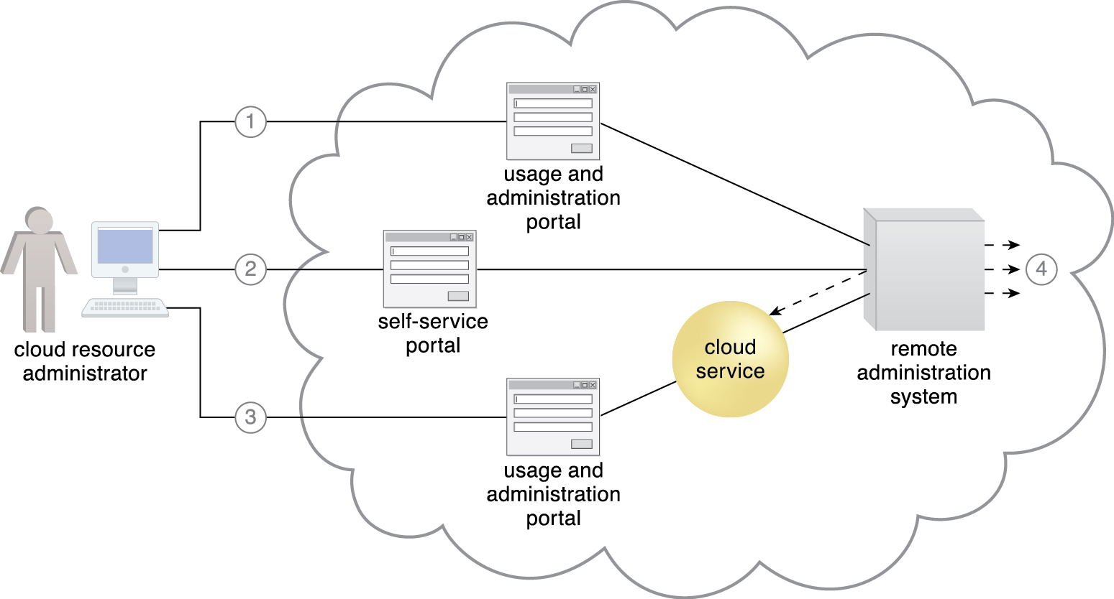
9.1. Remote Administration System
A cloud resource administrator uses the usage and administration portal to configure an already leased virtual server (not shown) to prepare it for hosting (1)
The cloud resource administrator then uses the self-service portal to select and request the provisioning of a new cloud service (2)
The cloud resource administrator then accesses the usage and administration portal again to configure the newly provisioned cloud service that is hosted on the virtual server (3)
Throughout these steps, the remote administration system interacts with the necessary management systems to perform the requested actions (4).
Figure 9.3
Notes:
Figure:

Slide 8
9.1. Remote Administration System
Depending on:
the type of cloud product or cloud delivery model the cloud consumer is leasing or using from the cloud provider,
the level of access control granted by the cloud provider to the cloud consumer, and
further depending on which underlying management systems the remote administration system interfaces with
tasks that can be performed by CC via a remote administration console include:
configuring and setting up cloud services
provisioning and releasing IT resource for on-demand cloud services
monitoring cloud service status, usage, and performance
monitoring QoS and SLA fulfillment
managing leasing costs and usage fees
managing user accounts, security credentials, authorization, and access control
tracking internal and external access to leased services
planning and assessing IT resource provisioning
capacity planning

Slide 9
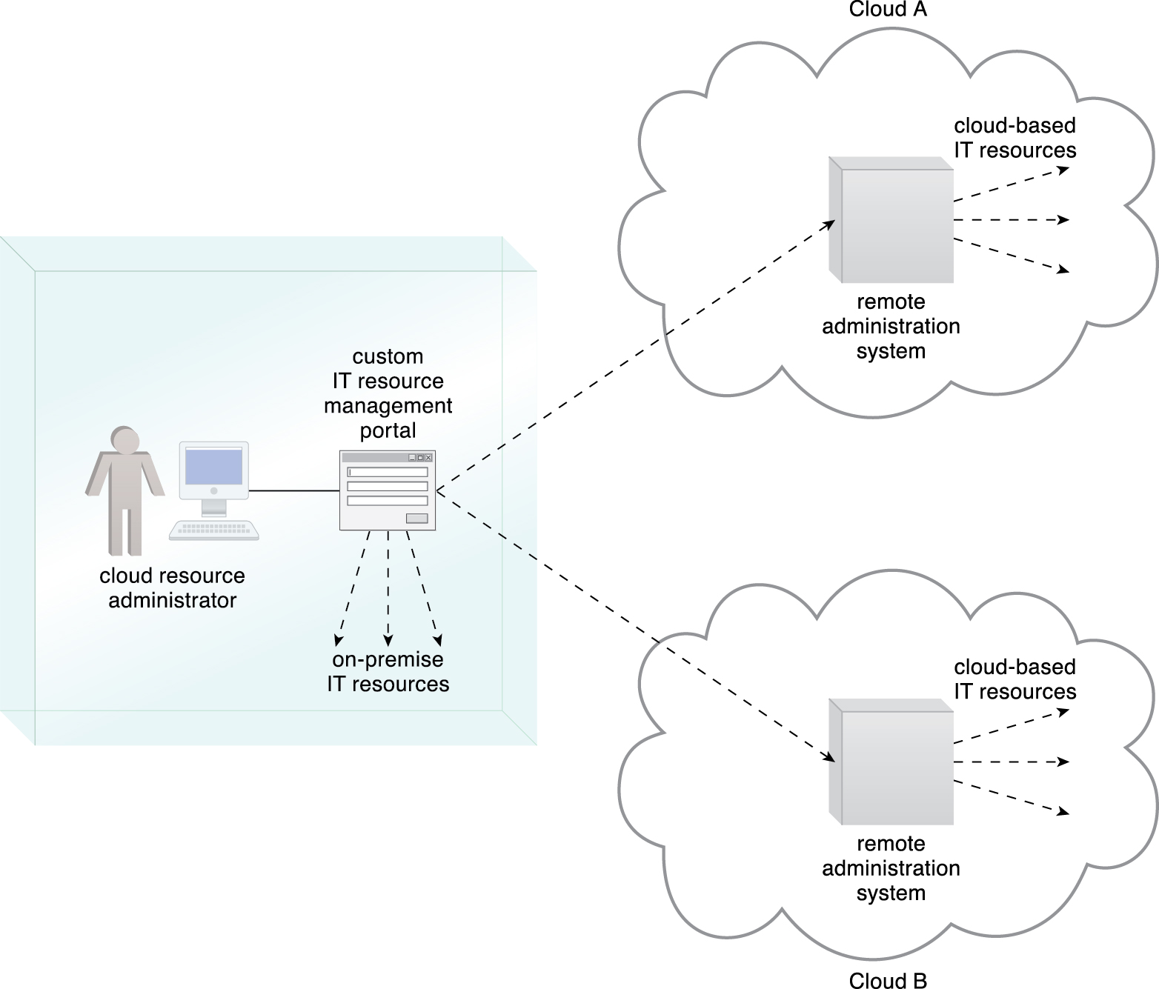
9.1. Remote Administration System
CP tend to have proprietary UIs
CC prefers standardized API
Allow CC to create their own front-end to be reused, if migration to a different CP who support standardized APIs, is necessary
Can leverage standardized API if leasing or centralizing IT resources among different CP or resources residing in a hybrid deployment
Figure 9.4 Standardized APIs published by remote administration systems from different clouds enable a cloud consumer to develop a custom portal that centralizes a single IT resource management portal for both cloud-based and on-premise IT resources.
Notes:
Figure:

Slide 10
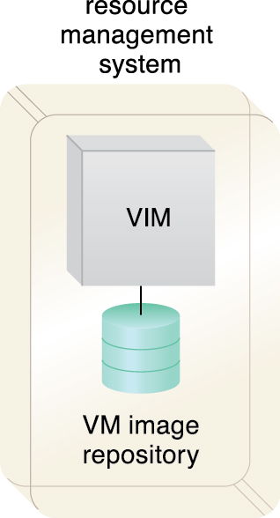
9.2. Resource Management System
The resource management system mechanism helps coordinate IT resources in response to management actions performed by both cloud consumers and cloud providers
Core to this system is the virtual infrastructure manager (VIM) that coordinates the server hardware so that virtual server instances can be created from the most expedient underlying physical server
Figure 9.5 A resource management system encompassing a VIM platform and a virtual machine image repository. The VIM may have additional repositories, including one dedicated to storing operational data.
Notes:
Figure:

Slide 11
9.2. Resource Management System
Tasks that are typically automated and implemented through the resource management system include:
managing virtual IT resource templates that are used to create pre-built instances, such as virtual server images
allocating and releasing virtual IT resources into the available physical infrastructure in response to the starting, pausing, resuming, and termination of virtual IT resource instances
coordinating IT resources in relation to the involvement of other mechanisms, such as resource replication, load balancer, and failover system
enforcing usage and security policies throughout the lifecycle of cloud service instances
monitoring operational conditions of IT resources

Slide 12
9.2. Resource Management System
Resource management system functions can be accessed by cloud resource administrators employed by the cloud provider or cloud consumer
Those working on behalf of a cloud provider will often be able to directly access the resource management system’s native console
Resource management systems can expose APIs that allow CPs to build customized remote administration system portals for resource management controls to external cloud resource administrators acting on behalf of cloud consumer organizations via usage and administration portals
Notes:
Figure:

Slide 13
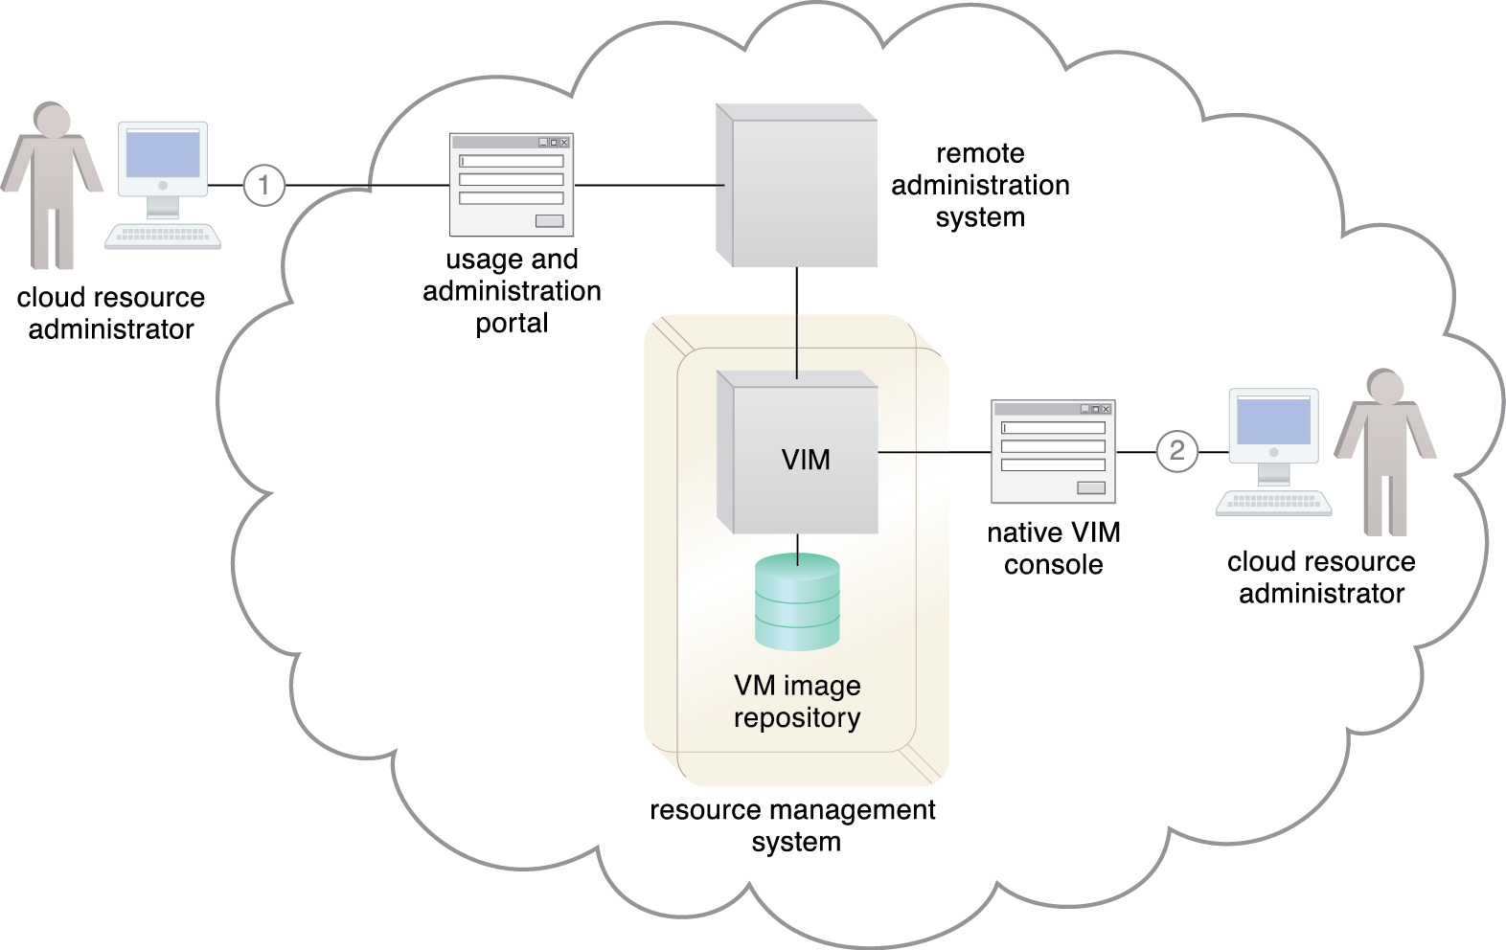
9.2. Resource Management System
The cloud consumer’s cloud resource administrator accesses a usage and administration portal externally to administer a leased IT resource (1)
The cloud provider’s cloud resource administrator uses the native user-interface provided by the VIM to perform internal resource management tasks (2).
Figure 9.6
Notes:
Figure:

Slide 14
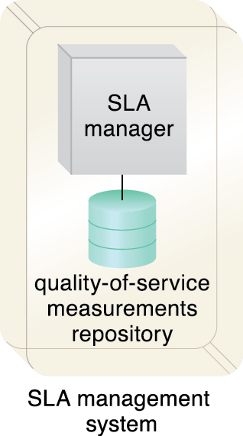
9.3. SLA Management System
The SLA management system mechanism represents a range of commercially available cloud management products that provide features pertaining to the administration, collection, storage, reporting, and runtime notification of SLA data
Figure 9.7 An SLA management system encompassing an SLA manager and QoS measurements repository.
Notes:
Figure:

Slide 15
9.3. SLA Management System
An SLA management system deployment will generally include a repository used to store and retrieve collected SLA data based on pre-defined metrics and reporting parameters
It will further rely on SLA monitor mechanisms to collect the SLA data that can then be made available in near-real time to usage and administration portals to provide on-going feedback regarding active cloud services
The metrics monitored for individual cloud services are aligned with the SLA guarantees in corresponding cloud provisioning contracts
Notes:
Figure:

Slide 16
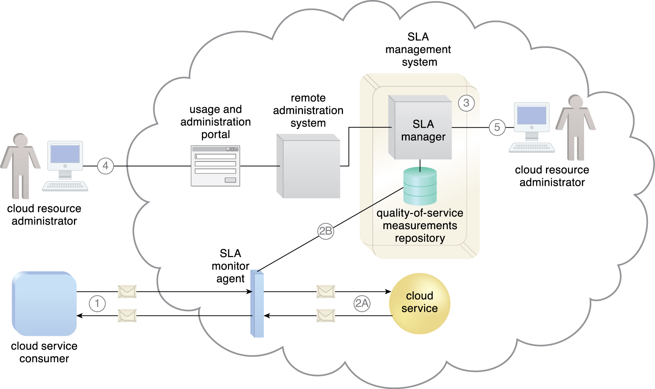
9.3. SLA Management System
A cloud service consumer interacts with a cloud service (1).
An SLA monitor intercepts the exchanged messages, evaluates the interaction, and collects relevant runtime data in relation to quality-of-service guarantees defined in the cloud service’s SLA (2A)
The data collected is stored in a repository (2B)
that is part of the SLA management system (3)
Queries can be issued and reports can be generated for an external cloud resource administrator via a usage and administration portal (4)
or for an internal cloud resource administrator via the SLA management system’s native user-interface (5).
Figure 9.8
Notes:
Figure:

Slide 17
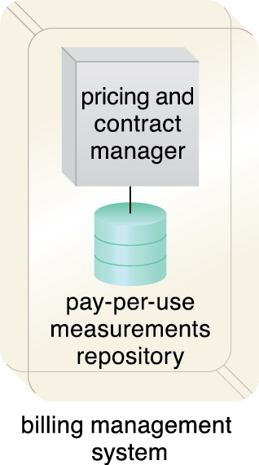
9.4. Billing Management System
The billing management system mechanism is dedicated to the collection and processing of usage data as it pertains to cloud provider accounting and cloud consumer billing
Specifically, the billing management system relies on pay-per-use monitors to gather runtime usage data that is stored in a repository that the system components then draw from for billing, reporting, and invoicing purposes
Figure 9.9 A billing management system comprised of a pricing and contract manager and a pay-per-use measurements repository.
Notes:
Figure:

Slide 18
9.4. Billing Management System
The billing management system allows for the definition of different pricing policies, as well as custom pricing models on a per cloud consumer and/or per IT resource basis
Pricing models can vary from the traditional pay-per-use models, to flat-rate or pay-per-allocation modes, or combinations thereof
Billing arrangements are based on pre-usage and post-usage payments
Post-usage payments can include pre-defined limits or it can be set up (with the mutual agreement of the cloud consumer) to allow for unlimited usage (and, consequently, no limit on subsequent billing)
When limits are established, they are usually in the form of usage quotas
When exceeded, the billing management system can block further usage requests by CC

Slide 19
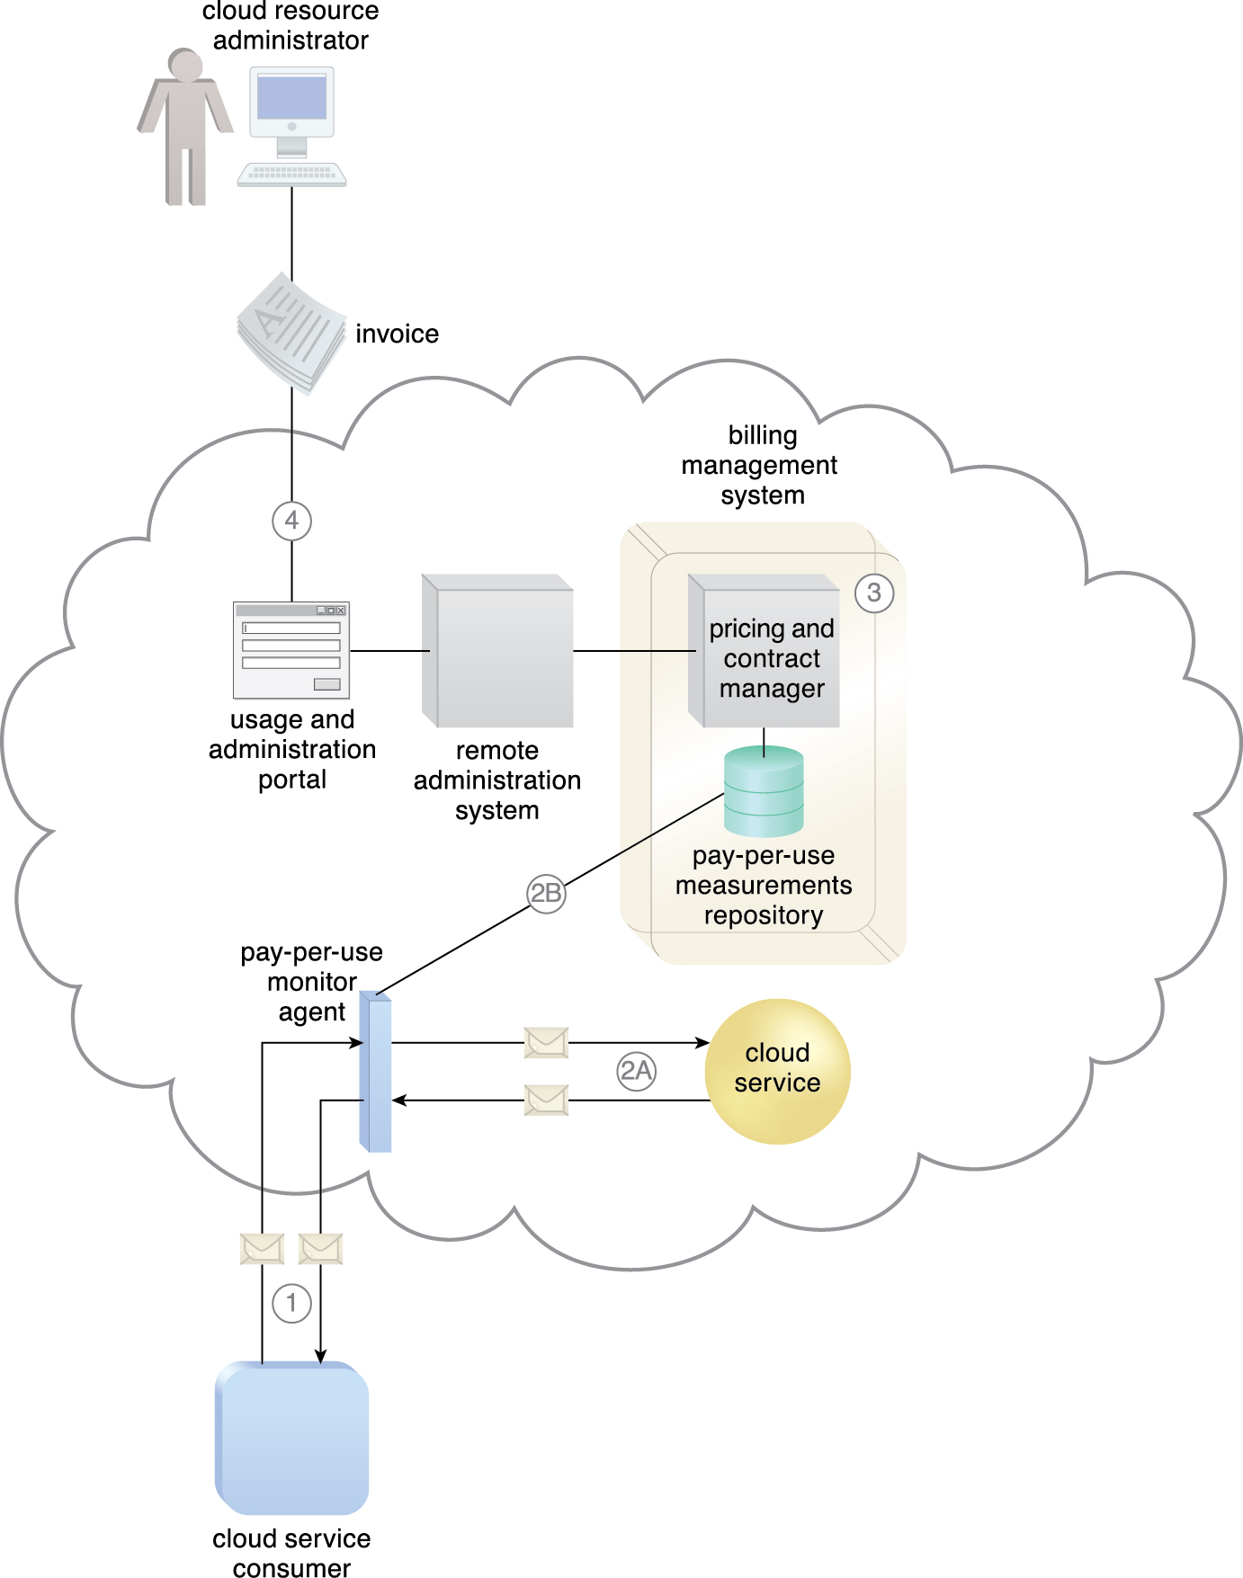
9.4. Billing Management System
A cloud service consumer exchanges messages with a cloud service (1)
A pay-per-use monitor keeps track of the usage and collects data relevant to billing (2A)
which is forwarded to a repository that is part of the billing management system (2B)
The system periodically calculates the consolidated cloud service usage fees and generates an invoice for the cloud consumer (3)
The invoice may be provided to the cloud consumer through the usage and administration portal (4).
Figure 9.10
Notes:
Figure:

